Slide 1

Floods in Uganda
A Research Project on Flood Management
Presented by: Daniel Wavamunno
Registration Number: S23B23/091

Slide 2

INTRODUCTION
Flooding is a natural process that occurs when the level of a body of water rises until it overflows its natural banks or artificial levees and submerges areas usually dry (Luino, F. 2016).

Slide 3

UGANDA
Each year, floods impact nearly 50,000 people in Uganda with an estimated annual cost of flood damage that is over $62 million (Ministry of Water and Environment, 2022).

Slide 4

BACKGROUND
Floods accounted for 6.8 million deaths in the 20th century, with Asia bearing nearly 50% of flood-related fatalities during the last quarter of that century.
In Pakistan, record monsoon rains led to unprecedented flooding that submerged one-third of the country. It is estimated that more than 33 million people were affected, with over 1,700 deaths and damages exceeding USD 30 billion(The United Nations Office for the Coordination of Humanitarian Affairs, 2022).
In 2023, in Libya following Storm Daniel, which caused catastrophic flooding in the city of Derna, resulting in over 11,000 deaths and leaving thousands missing. (OCHA,2023).

Slide 5
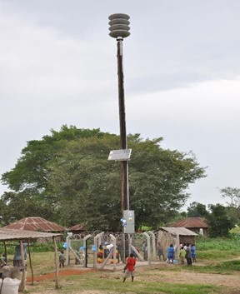
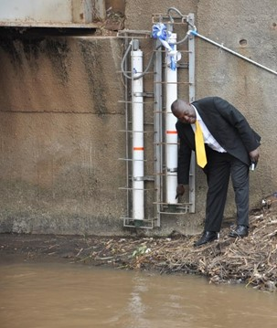
FLOOD DETECTION USING ICT’S(UGANDA)
In 2014, the Government of Uganda, in partnership with the International Telecommunication Union (ITU), implemented a solar-powered Flood Early Warning System on Namulo bridge in Butaleja district on River Manafwa. This system alerts residents of rising water levels, helping to prevent loss of life and property(ITU, 2014).

Slide 6
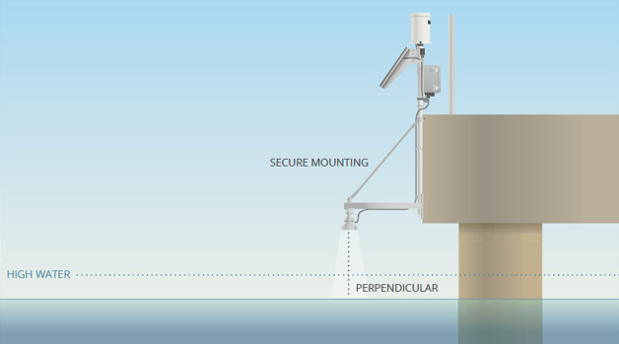
Multi-Radar Multi-Sensor System(United States of America)
MRMS integrates data from multiple sources like radars, satellites, weather stations, and lightning detection systems to estimate and forecast rainfall and potential flood risks. MRMS is particularly effective at detecting flash floods and heavy rainfall over large areas(Smith at el, 2016).
ultrasonic – pressure transducers – flow rate – temperature – humidity - wind -
MODIS(on NASA Terra1999-Aqua2002) - Sentinel-1 & Sentinel-2

Slide 7
METHODOLOGY [PROPOSED SOLUTION] - AN EMBEDDED AND MACHINE LEARNING FLOOD MONITORING AND WARNING SYSTEM -
Embedded Technologies
- Esp-32
- Ultrasonic sensor
- Flow sensor
- Buzzer
- Liquid Crystal Display(LCD)
Machine Learning Models
- Random Forest

Slide 8
PROPOSED SOLUTION
The proposed system focuses on developing a prototype of an embedded and machine learning flood monitoring and early warning system. It integrates ultrasonic sensors for real-time water level measurement and flow sensors to track water flow rates. The system also includes an LCD display for real-time status updates and a buzzer for audible alerts, ensuring a comprehensive and accessible solution for flood warning​s.

Slide 9
CONTINUATION
The micro-controller(ESP-32) then sends data collected from the sensors to a Google Sheets document. The data is collected for future references.
This data is then used to make predictions for future flooding events and can easily be viewed on a dashboard.

Slide 10
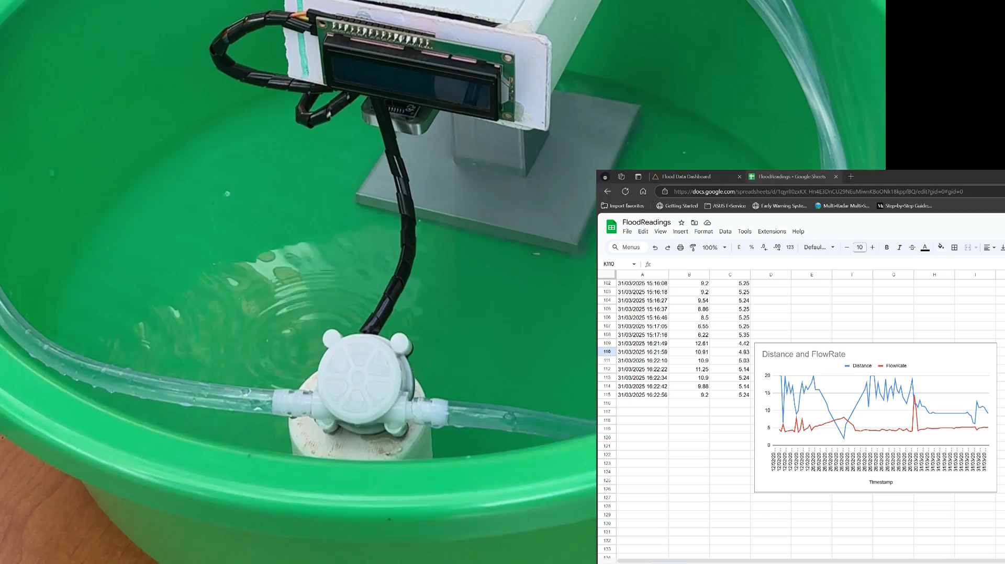
DEMONSTRATION OF THE PROTOTYPE

Slide 11
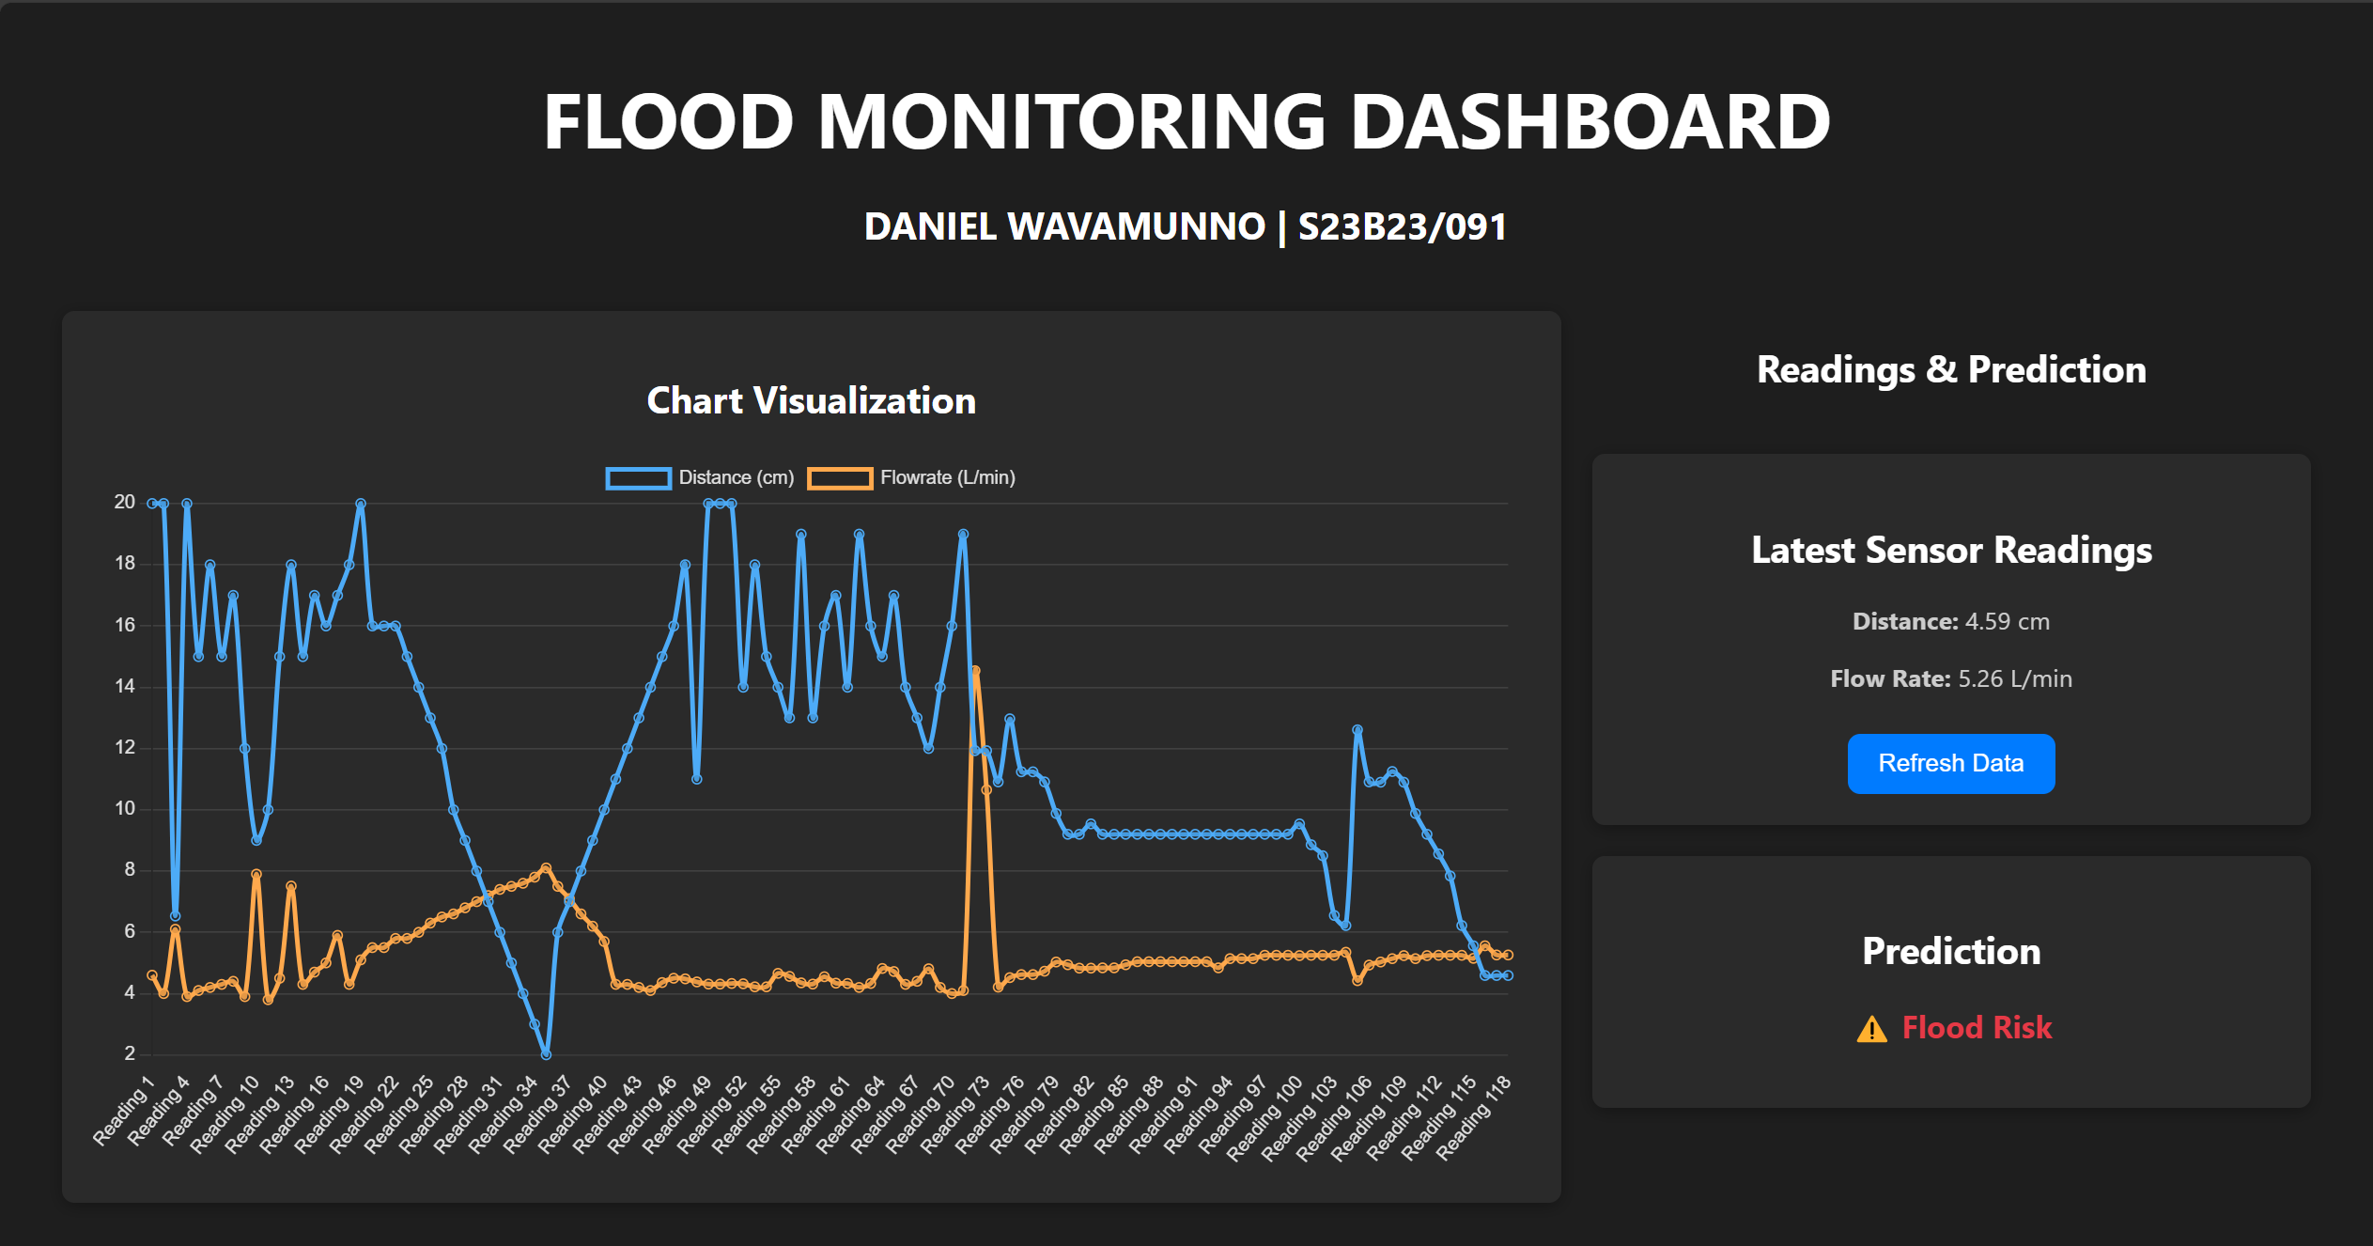
MONITORING DASHBOARD

Slide 12
CHALLENGES
Limited historical data
Accessing embedded systems components in Uganda
Sensor accuracy & calibration

Slide 13
References
DTM. (2023). El Niño Impact Tracking 2023/2024. DTM Uganda.
Luino, F. (2016). Floods. In: Bobrowsky, P., Marker, B. (eds) Encyclopedia of Engineering Geology. Encyclopedia of Earth Sciences Series. Springer, Cham. https://doi.org/10.1007/978-3-319-12127-7_126-1
Ministry of Water and Environment, Climate Change Department, 2022. Floods and Heat Stress in Uganda, Report 2022.
OCHA, "Floods in Pakistan: Rethinking the humanitarian role," Humanitarian Outcomes, 2022.
OCHA, "Libya: Flood Response Humanitarian Update (as of 15 December 2023)," 2023.
UNDRR, "Global Assessment Report on Disaster Risk Reduction," United Nations Office for Disaster Risk Reduction, 2022.
ITU, "Early Warning Systems for Flood Management in Uganda," International Telecommunications Union, 2014.
Travis M. Smith at el, "Multi-Radar Multi-Sensor (MRMS) Severe Weather and Aviation Products: Initial Operating Capabilities,“ https://doi.org/10.1175/BAMS-D-14-00173.1, Page(s): 1617–1630, 2016.

